Slide 1




SMART GARBAGE MONITORING SYSTEM USING IOT K.AJAY REDDY (1602-20-733-002) G.KRISHNA SAMEER (1602-20-733-013)

Slide 2
ABSTRACT:
The paper is based on the concept of Automation used in waste management system under the domain of Cleanliness and Hygiene. Dumping garbage onto the streets and in public areas is a common synopsis found in all developing countries and this mainly end up affecting the environment and creating several unhygienic conditions. In order to deal with these problems Smart dustbin is an ideology put forward which is a combination of hardware and software technologies i.e. connecting Wi-Fi system to the normal dustbin in order to provide free internet facilities to the user for a particular period of time. The technology awards the user for keeping the surrounding clean and thus work hand in hand for the proper waste management in a locality. Smart dustbin uses multiple technologies firstly the technology for measuring the amount of trash dumped secondly the movement of the waste and lastly sending necessary signals and connecting the user to the Wi-Fi system. Whenever the maximum level is reached, alert will be sent to the local authorities.

Slide 3
MOTIVATION:
The problem of waste management: You could highlight the issue of improper waste management in developing countries and the negative impact it has on the environment and public health. This could include statistics and real-life examples of the problem.
The need for innovative solutions: You could explain that traditional methods of waste management have not been effective in addressing the problem, and there is a need for innovative solutions that can incentivize people to dispose of their waste properly.
The potential benefits of Smart netbin: You could discuss the advantages of using Smart netbin, such as the provision of free internet facilities and the ability to encourage people to keep their surroundings clean. You could also highlight the potential for Smart netbin to be scaled up and implemented in other areas, thereby contributing to a cleaner and more hygienic environment.

Slide 4
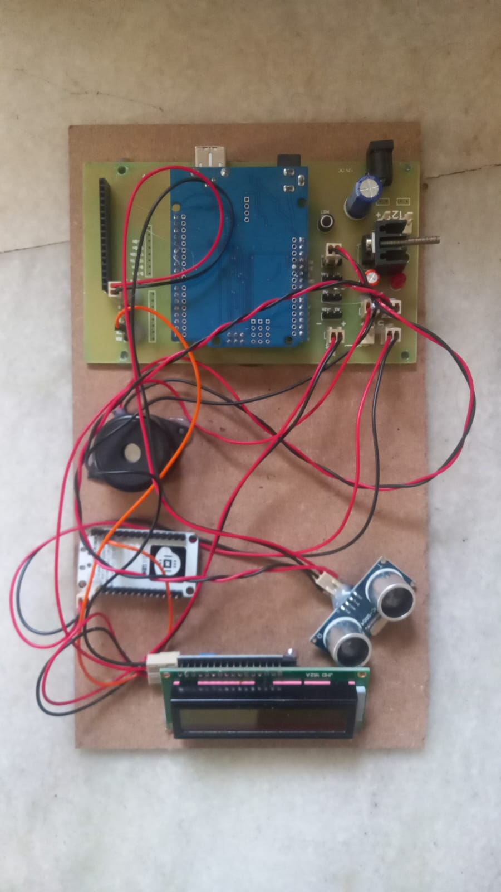

Slide 5
METHODOLOGY:
Arduino Uno is a microcontroller board based on the ATMEGA328P.It contains everything needed to support the microcontroller, simply connect it to a computer with a USB cable or power it with a AC to DC adapter or battery to get started. The command is an instruction given to LCD to do a predefined task like initializing it, clearing its screen, setting the cursor position, controlling display etc. The data register stores the data to be displayed on the LCD. APR9600 device offers true single-chip voice recording, non-volatile storage, and playback capability for 40 to 60 seconds. Sample rates are user-selectable, allowing designers to customize their design for unique quality and storage time needs.

Slide 6
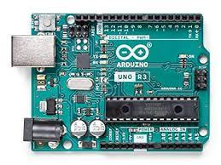
AURDINO UNO

Slide 7
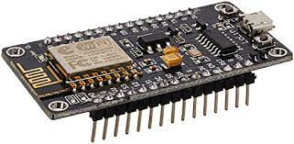
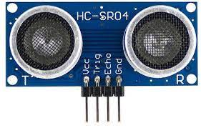
NODE MCU ULTRASONIC SENSOR

Slide 8
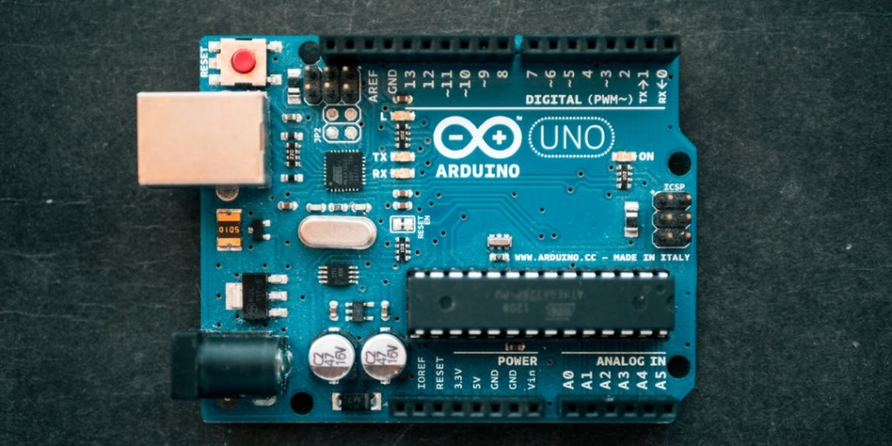
Arduino IDE :
The Arduino IDE (Integrated Development Environment) is the program used to write code, and comes in the form of a downloadable file on the Arduino website. The Arduino board is the physical board that stores and performs the code uploaded to it.
It makes it easy to write code and upload it to the board. It runs on Windows, Mac OS X, and Linux. The environment is written in Java and based on Processing and other open-source software.

Slide 9
CONCLUSION
Improper disposal and improper maintainance of domestic waste create issues in public health and environment pollution thus this paper attempts to provide practical solution towards managing the waste collaborating it with the use of IOT i.e. providing free internet facilities for a specific time once the trash is dumped into the bin. the proposed system will definitely help to overcome all the serious issues related to waste and keep the environment clean.

Slide 10
THANK YOU

